Slide 1

FXEC BOOK DONORS CLUB
BY
P. Sankara isai selvam

Slide 2
Tech Requirements
HTML
CSS
JQUERY

Slide 3

PROBLEM STATEMENT
Create a HTML web page
Give input details using input field
Display the details entered below in a table format

Slide 4
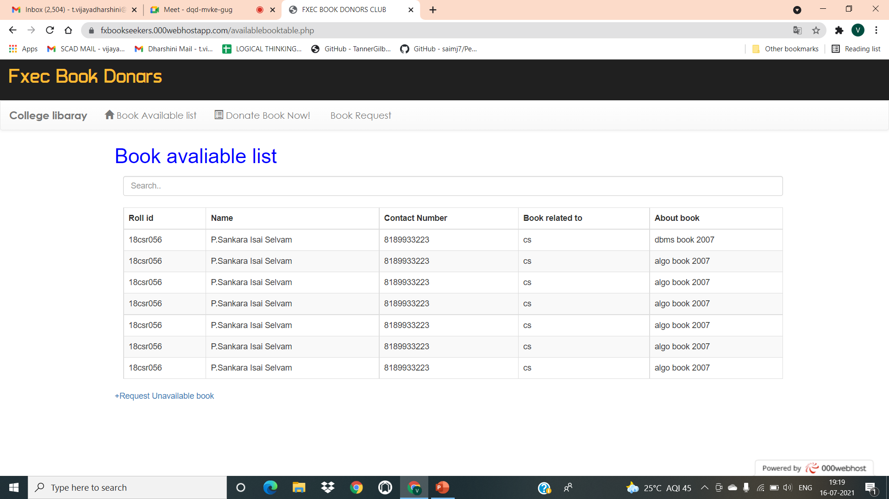
CREATE A HTML WEB PAGE

Slide 5
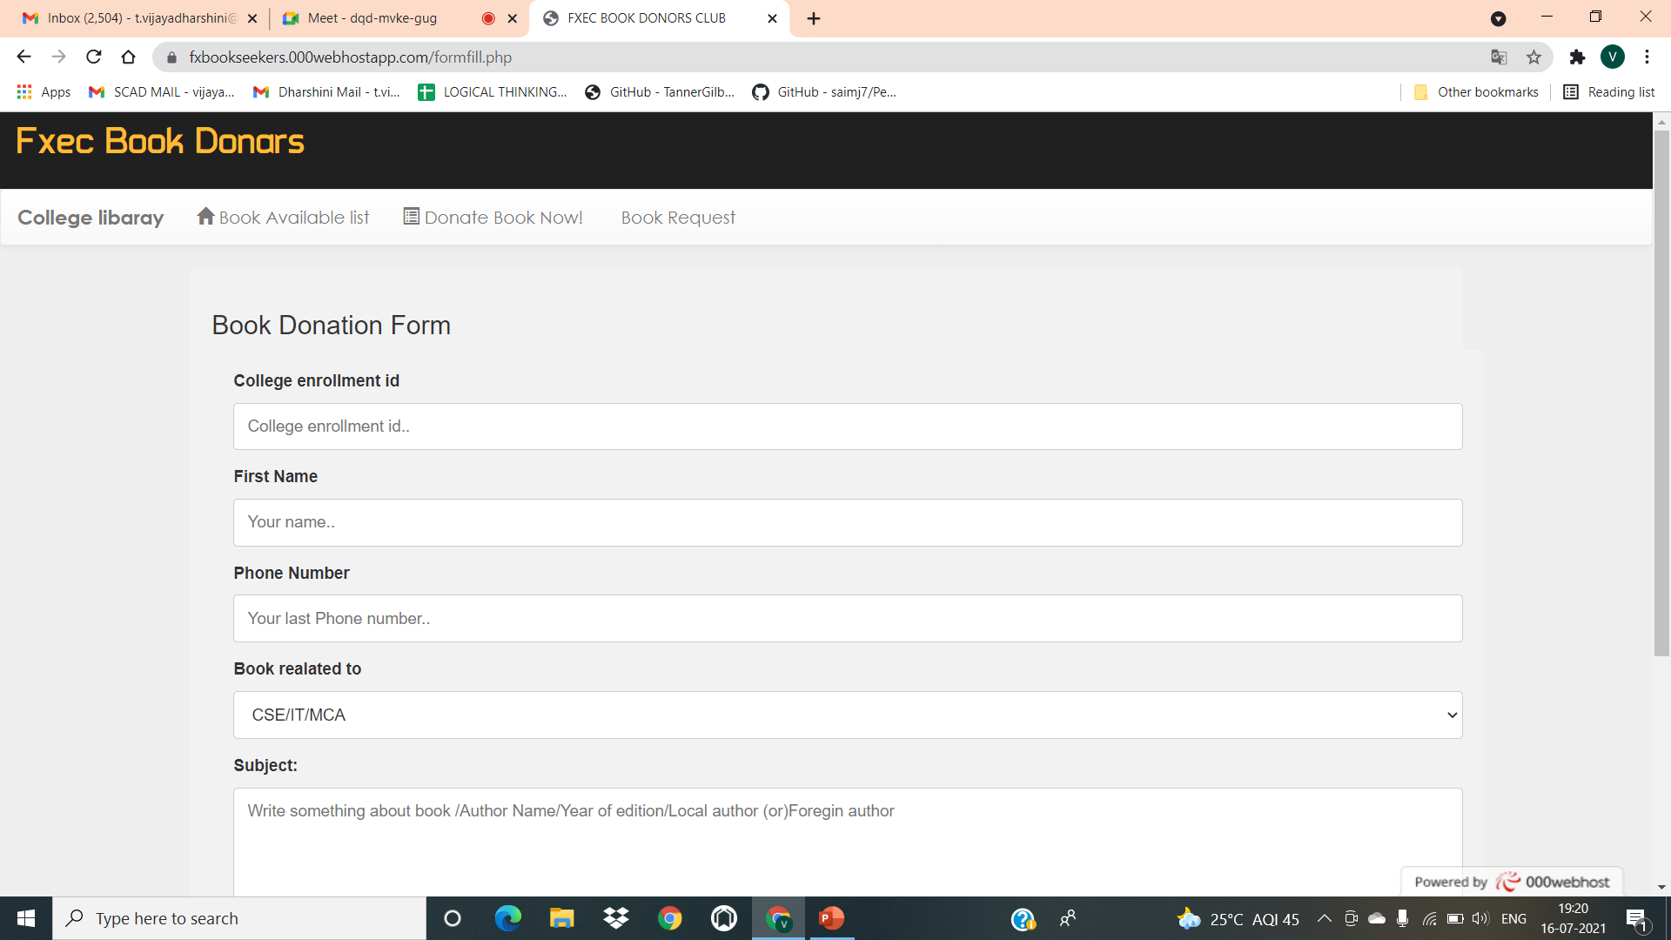
Give input details using input field

Slide 6
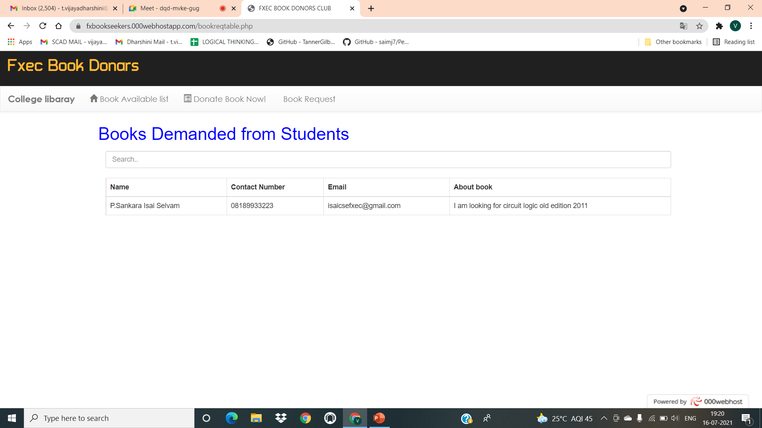
Display the details entered below in a table format

Slide 7

Thank You

